Slide 1
Mrs. Henry
Adv. Math Course 2, Math Course 2, Avid 7
Canyon Lake Middle School

Slide 2
Introduction
15th Year Teaching
Multiple subject credential with an emphasis in mathematics
Intensive professional development background in mathematics
Algebraic Project/Curriculum writing for LEUSD
Personal – have lived in community for last 30 years

Slide 3
Advanced Math Course 2 (Periods 5 and 6)
Fast Paced – 2nd half of 7th grade math and 8th grade math
Goal to be ready for Algebra 1 in 8th grade
Curriculum “Big Ideas Math” by Ron Larson and Laurie Boswell and Illustrative Mathematics written by the writers of the Common Core Curriculum
Conceptual understanding Procedural Understanding Combines both for real life application
Standards for Mathematical Practices built into all lessons
Technology built into lessons

Slide 4
Math Course 2 – (Periods 2 and 4)
Curriculum “Big Ideas Math” by Ron Larson and Laurie Boswell and Illustrative Mathematics written by the writers of the Common Core Curriculum
Conceptual understanding Procedural Understanding Combines both for real life application
2 days per lesson, allows for math workshop, group work, activity application, games, fluency practice
Standards for Mathematical Practices built into all lessons
Technology built into lessons

Slide 5
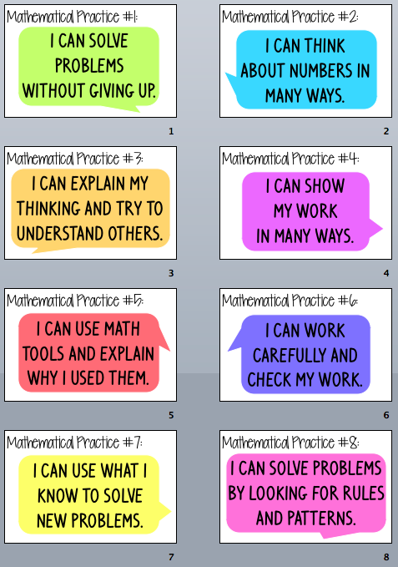
Standards for Mathematical Practices

Slide 6
Math Class Norms

Slide 7
Classroom Management
Consistency and Fairness
My classroom expectations and rules hold all students accountable
My promise to all my students
Modeling expectations clearly
High Expectations
Intrinsic Motivation
Engaging classroom and lessons

Slide 8
Classroom Expectations/Rules
Classroom Expectations
Classroom Rules
Be kind and respectful
Be on-time and prepared
Be on task and productive
Follow directions the first time they are given
Be proactive and responsible
Students will be discussing and writing our classroom rules during the first week of class

Slide 9
Supplies (Math Classes)
Daily Student Supplies
Classroom Donations (Optional)
A binder with tabs for each class
Composition Book for a Math Journal (No spiral bound notebooks please)
Writing utensils- pencils for math assignments/colored pens for correcting, 2 dry erase markers
A positive attitude, a sense of humor, & an open mind
Please have your supplies by: 8/20
Kleenex
Graph Paper/Notebook paper
Markers (thick and thin), colored pencils
Rulers, scissors,
Sticky notes, cardstock,
Dry erase markers,
Pencils, erasers,

Slide 10
How You Can Support Your Student
Encourage a Mathematical Mindset (Growth mindset)
Check Jupiter Ed regularly
Encourage your student to be proactive and responsible – completing classwork and homework, asking for help when they do not understand, setting up tutoring appointments, and use “Request to retake a test” if necessary
Positive open mind ☺

Slide 11
How to Contact Me
Jupiter Ed – www.jupitergrades.com – grades will be updated weekly
Email –bonnie.henry@leusd.k12.ca.us – expect reply within 24 hours
Website – www.mathwithmrshenry.weebly.com

Slide 12
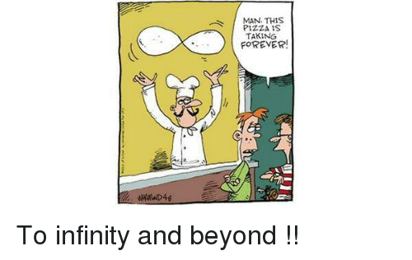
Questions
Any questions I did not answer?
I’m looking forward to an engaging and productive year with your student.
Thank you for coming tonight ☺

Slide 13
Mrs. Henry
Adv. Math Course 2, Math Course 2, Avid 7
Canyon Lake Middle School

Slide 14
Introduction
15th Year Teaching
Multiple subject credential with an emphasis in mathematics
Intensive professional development background in mathematics
Algebraic Project/Curriculum writing for LEUSD
Personal – have lived in community for last 30 years

Slide 15
AVID7 – Period 3
AVID’s mission is to close the achievement gap by preparing all students for college readiness and success in a global society.​
Advancement Via Individualized Determination
College Preparatory Elective - WICOR: Writing, Inquiry, Collaboration, Organization, and Reading

Slide 16
What AVID is….
A direct support structure for students’ academic and career success.​
A structured, college preparatory system working directly with schools and districts.​
A schoolwide approach to curriculum and rigor adopted by nearly 4,500 schools in 45 states and 15 countries.​
A program NOT just an elective course! Attendance to events and trips is crucial!​
AVID strategies support the Common Core State Standards.​ ​

Slide 17
What AVID is not…..
AVID is not a remedial program​
AVID is not a free ride!​
AVID is not a magical class that will make your student organized and successful!​
AVID isn’t a college outreach program​

Slide 18
What to expect in your Avid Class
Introduction to WICOR strategies (Writing, Inquiry, Collaboration, Organization, Reading
Grade/Binder Checks
Tutorials – College Tutors come in to help
Fun Classroom Activities
University Visits
Field Trips
Family Fun Nights
Leadership Opportunities

Slide 19
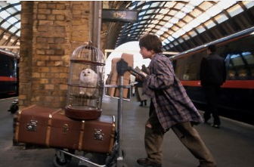
Avid Events
First Event: ICE Cream Social​ - Invitation attached
College Tour Field Trip (2)
Knotts Berry Farm
Movie Night
Christmas Party
Universal Studios
Fund Raisers to make this happen – Fundraiser is “Shop for a Cause”
Each Student is asked to sell at least 5 tickets – This pay for some of the events for them

Slide 20
Classroom Expectations/Rules
Classroom Expectations
Be kind and respectful
Be on-time and prepared
Be on task and productive
Follow directions the first time they are given
Be proactive and responsible

Slide 21
Supplies - AVID
Daily Student Supplies
Classroom Supplies (Optional)
One 2-3 inch binder to use for all your classes (3 ring—no according type)
Binder dividers for each class
Writing Utensils—Pencils (Lots), Pens—Blue, black, and red, Highlighters, erasers, dry erase markers (2)
Pencil Pouch to put all supplies in
Glue stick, ruler, scissors
Supplies required to complete any assignment will always be available to take home! All you need to do is ask!
Kleenex
Graph Paper/Notebook paper
Markers (thick and thin), colored pencils
Rulers, scissors,
Sticky notes, cardstock,
Dry erase markers,
Pencils, erasers,

Slide 22
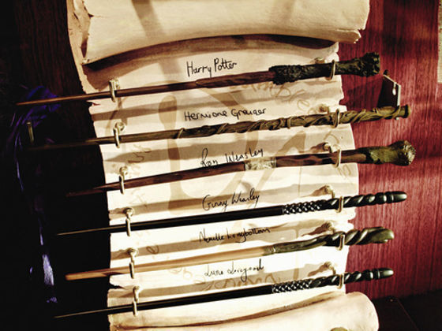
How to Contact Me
Jupiter Ed – www.jupitergrades.com – grades will be updated weekly
Email –bonnie.henry@leusd.k12.ca.us – expect reply within 24 hours
Website – www.mathwithmrshenry@weebly.com

Slide 23
Questions
Any questions I did not answer?
I’m looking forward to a fun, exciting, and productive year with your student.
Thank you for coming tonight ☺

