Slide 1
Math Course 2 - ADV Period 5 Tues. Nov. 13, 2018 Agenda: Warm Up/Check in Homework Efficiently Solving Inequalities Team Activities – Exercises 15.2, 15.3 on white boards
Homework:
Read Lesson Summary and complete Key Points, Questions, and Summary in Journal Notes
Illustrated Math Practice Problems 6.15
COME IN QUIETLY – PUT HOMEWORK OUT ON DESK – WRITE DOWN AGENDA – START WARM UP NOW
WARM UP - DO NOW
15.1: Lots of Negatives
Here is an inequality: $−x≥−4$.
Predict what you think the solutions on the number line will look like.
Select all the values that are solutions to $−x≥−4$:
3
-3
4
-4
4.001
-4.001
Graph the solutions to the inequality on the number line:
EQ: HOW IS SOLVING EQUATIONS SIMILAR AND DIFFERENT TO SOLVING INEQUALITIES?

Slide 2
Math Course 2 - ADV Period 6 Tues. Nov. 13, 2018 Agenda: Warm Up/Check in Homework Efficiently Solving Inequalities Team Activities – Exercises 15.1, 15.2 on white boards
Homework:
Finish Lesson 15 –
Do 15.2 1-3, 15.3 1-2
COME IN QUIETLY – PUT HOMEWORK OUT ON DESK – WRITE DOWN AGENDA – START WARM UP NOW
WARM UP - DO NOW
15.1: Lots of Negatives
Here is an inequality: $−x≥−4$.
Predict what you think the solutions on the number line will look like.
Select all the values that are solutions to $−x≥−4$:
3
-3
4
-4
4.001
-4.001
Graph the solutions to the inequality on the number line:
EQ: HOW IS SOLVING EQUATIONS SIMILAR AND DIFFERENT TO SOLVING INEQUALITIES?

Slide 3
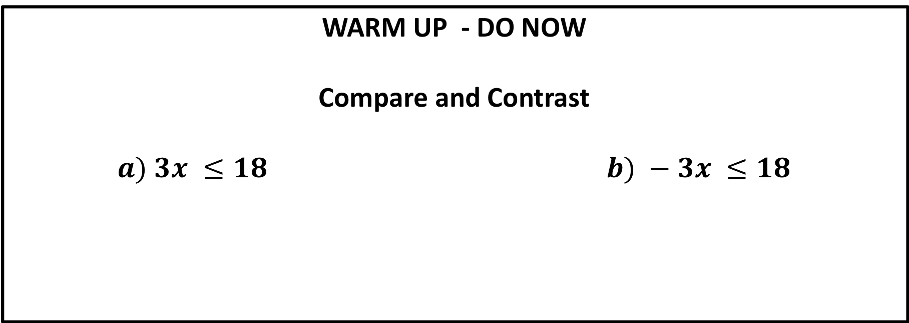
Math Course 2 - ADV Period 5 Wed . Nov. 14, 2018 Agenda: Warm Up/Check in Homework Efficiently Solving Inequalities – Finish 15.3 Summary, Exit Ticket, Start Homework
Homework:
Big Ideas Pg 483, #1 -24
COME IN QUIETLY – PUT HOMEWORK OUT ON DESK – WRITE DOWN AGENDA – START WARM UP NOW
WARM UP - DO NOW
Compare and Contrast
$$a) 3x ≤18 b) −3x ≤18$$
EQ: HOW IS SOLVING EQUATIONS SIMILAR AND DIFFERENT TO SOLVING INEQUALITIES?

Slide 4
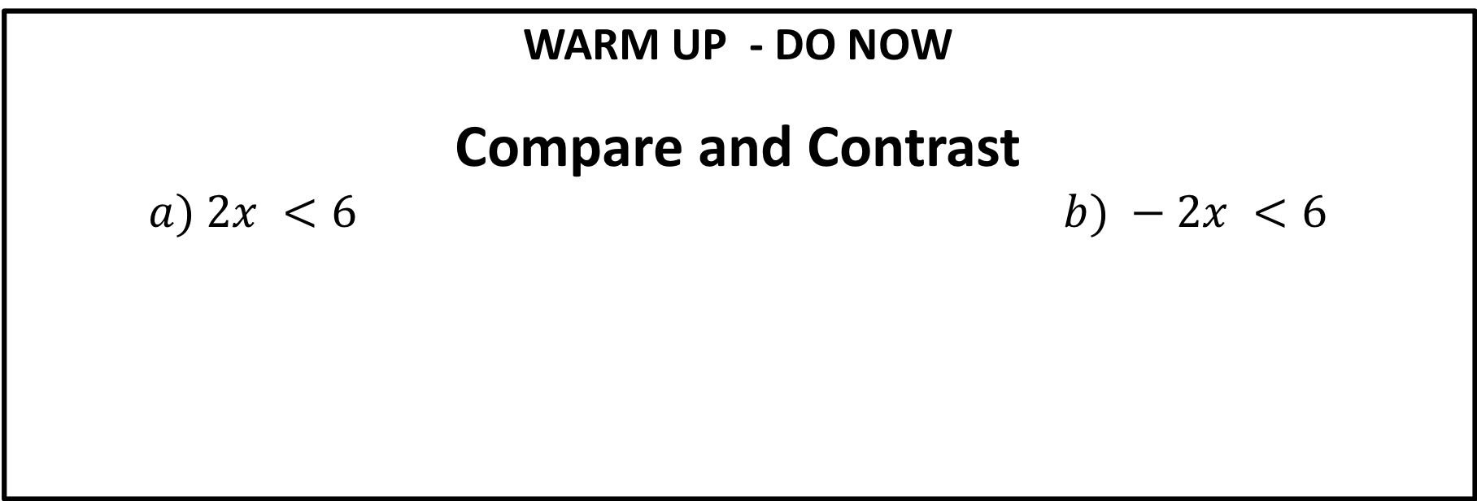
Math Course 2 - ADV Period 6 Wed Nov 14, 2018 Agenda: Warm Up/Check in Homework Efficiently Solving Inequalities Team Activities – Exercises 15.2, 15.3 on white boards
Homework:
Read Lesson Summary and complete Key Points, Questions, and Summary in Journal Notes
Illustrated Math Practice Problems 6.15
COME IN QUIETLY – PUT HOMEWORK OUT ON DESK – WRITE DOWN AGENDA – START WARM UP NOW
WARM UP - DO NOW
Compare and Contrast
$$a) 2x <6 b) −2x <6$$
EQ: HOW IS SOLVING EQUATIONS SIMILAR AND DIFFERENT TO SOLVING INEQUALITIES?

